Slide 1
Automated Home Bar
Prepared for:
Dr. Wilson, Professor
Dr. McCracken, Advisor
Prepared by:
Robert Graham
Patrick Keeven
Joshua Sneller
Ross Tooker

Slide 2
Areas of Importance
Introduction
Initial Goals
Technical Issues
Progress/Timeline
Detailed Technical Discussion
Block Diagrams
Parts
Financial Summary
Future Goals

Slide 3
Introduction
Initial design
1. To design and build a device that automates many functions of a bartender
2. Our initial design will have three different varieties of alcohol, with cola or tonic water as a mixer
3. Device will mix these liquids together to produce different mixed drinks
Reasons for making an automated home bar
1. Always a perfect drink
2. Sometimes don’t feel like mixing a drink
3. Remembering what ingredients are in each drink

Slide 4
Initial Goals
The capability to make three to five separate drinks
A convenient user interface to choose which one of the three to five drinks he/she would like
An accurate mixing of the drink selected

Slide 5
Technical Issues
Financial
1. Flow meters
2. Solenoid operated valves
Flow Control
1. Pump
2. Reservoir
3. Solenoid operated valves

Slide 6
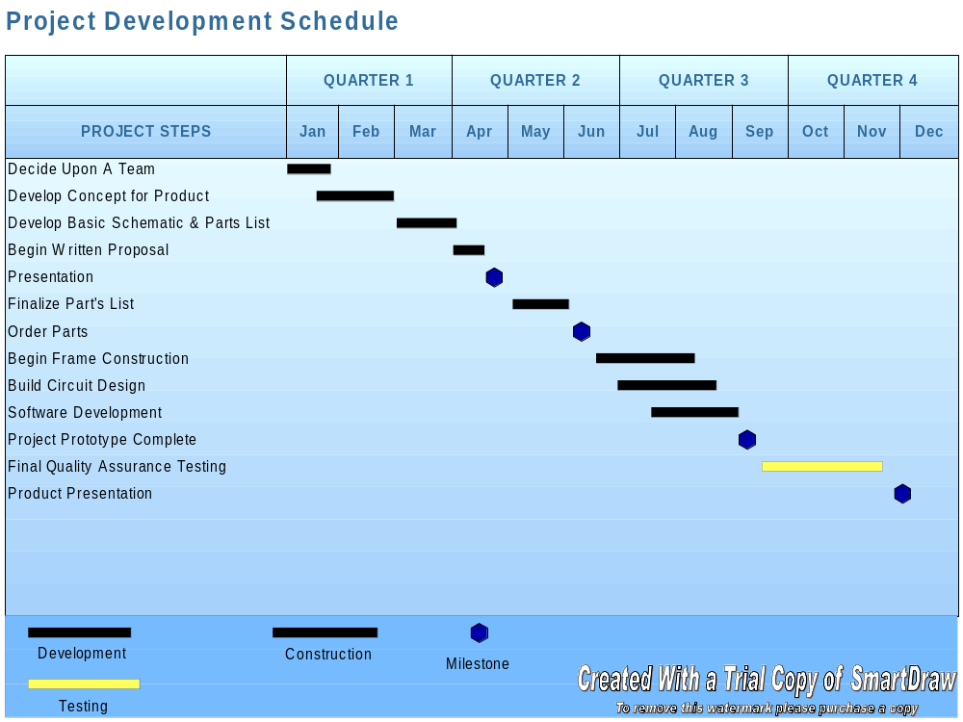


Slide 7
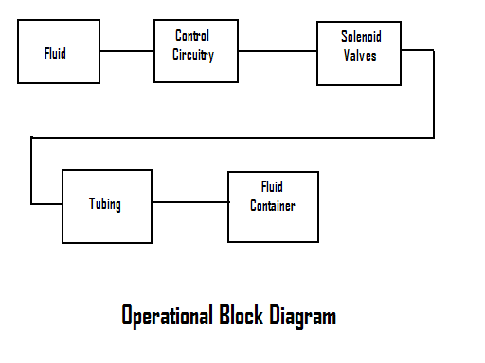
Operational Block Diagram

Slide 8
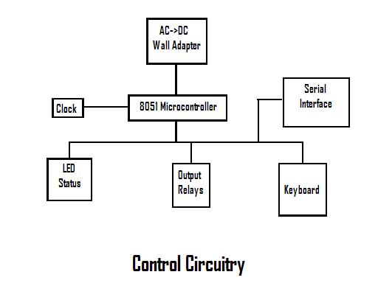
Control Circuitry

Slide 9
Parts
Microcontroller $7
Flow Control Boxes $100
Transformer-110AC ->5v $10
Solenoid Operated Valves $20eachx4=$80
Breadboard $20
Building Supplies $50
Misc. Electronic Supplies $40
Max233 Programmer $5

Slide 10
Future Goals
A touch screen would vastly improve the user interface
The ability to add types of liquor and drinks to the machine after production would also make the machine much more user friendly
Allow the user to choose his/her own amounts of different types of liquor to be put into specific drinks

Slide 11
Questions?
Thank you for your time.

